Slide 1

Human Speech Production

Slide 2
Contents
The Process of Speech Production
Short-Time Fourier Representation of Speech
Acoustic Phonetics
Distinctive Features of The Phonemes English

Slide 3
The Process of Speech Production

Slide 4
The Process of Speech Production
Introduction
Definition of Speech Production
Speech production refers to the process by which humans generate spoken language through the coordinated actions of various anatomical structures.
Importance of Understanding Speech Production
It is essential for studying speech disorders, designing speech technologies, and improving language learning and communication.

Slide 5
The Process of Speech Production
Anatomy of Speech Organs
Respiratory System
The diaphragm and
intercostal muscles
control airflow from
the lungs through the
trachea (windpipe)
And into the vocal tract.
Phonatory System
The larynx (voice box)
houses the vocal folds
(vocal cords), which
vibrate when air passes
through, producing
voiced sounds.
Articulatory System
Includes the tongue,
lips, teeth, palate, and
jaw, which shapes the
airflow into specific
speech sounds
(consonants and vowels)

Slide 6
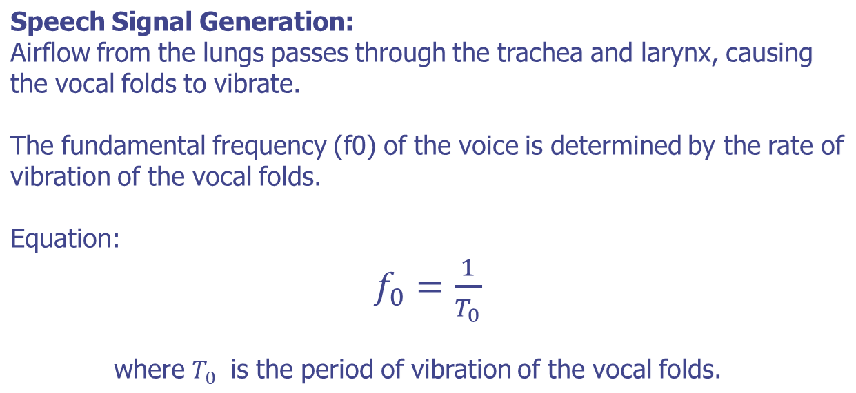
The Process of Speech Production
Physiology of Speech Production

Slide 7
The Process of Speech Production
Phonation Process
Vocal Folds and Glottis
  The glottis is the opening between the vocal folds in the larynx.
  Phonation occurs when the vocal folds vibrate due to airflow, producing a buzzing sound.
Types of Phonation
  Modal voice (normal phonation), breathy voice (increased airflow), and creaky voice (decreased airflow).

Slide 8
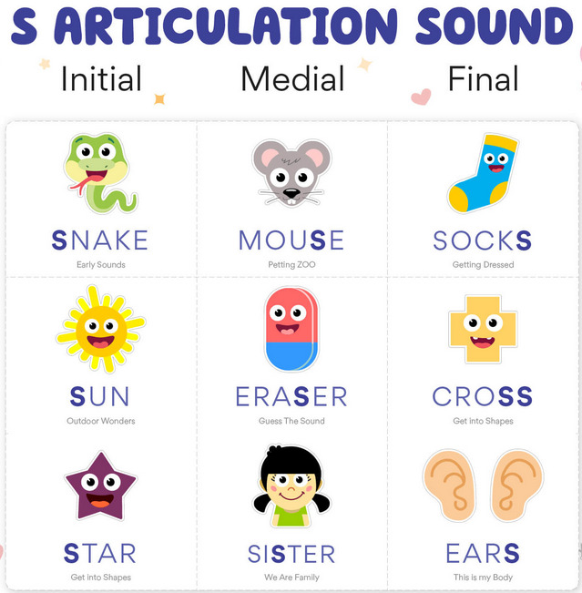
The Process of Speech Production
Articulation of Speech Sounds
Role of Articulators
Articulators such as the lips, tongue, teeth, palate, and jaw shape the vocal tract to produce different speech sounds.
Place and Manner of Articulation
Speech sounds are classified based on where (place) and how (manner) they are produced in the vocal tract (e.g., bilabial, alveolar, velar).

Slide 9
The Process of Speech Production
Neural Control of Speech
Brain Areas Involved
The motor cortex, Broca's area, cerebellum, and brainstem regions coordinate speech movements and control muscle activity.
Neural Pathways
Motor commands for speech are transmitted via cranial nerves to the muscles of the speech organs.

Slide 10
The Process of Speech Production
Neural Control of Speech
Motor Cortex and Motor Planning
The motor cortex in the brain plans and executes voluntary movements, including speech
articulation.
Broca's Area and Speech Production
Broca's area, located in the frontal lobe, is involved in the motor planning of speech
production.
Cerebellum and Motor Coordination
The cerebellum coordinates and refines motor movements, ensuring precise articulation
during speech production.

Slide 11
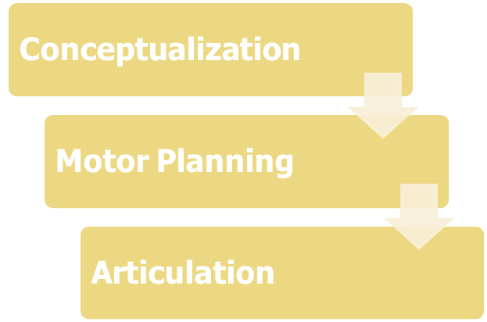
The Process of Speech Production
Stages of Speech Production

Slide 12
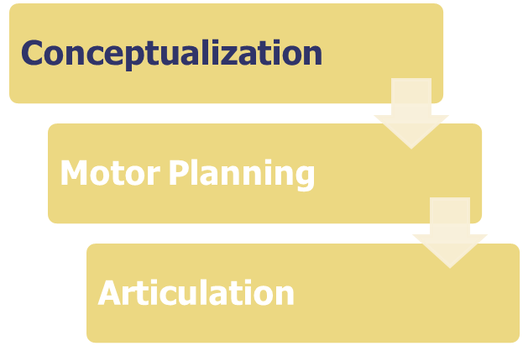
The Process of Speech Production
Stages of Speech Production
The speaker forms
linguistic concepts
and selects
appropriate words
and sentences to
convey meaning

Slide 13
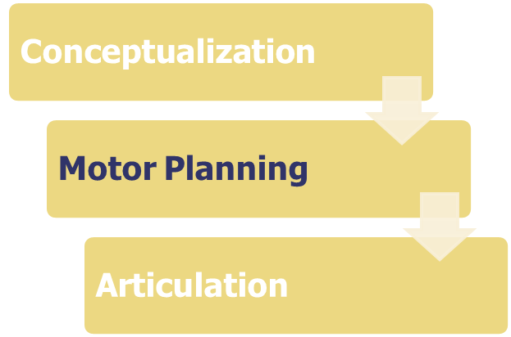
The Process of Speech Production
Stages of Speech Production
Neural signals from
the brain translate
linguistic
representations
into motor
commands for
speech movements

Slide 14
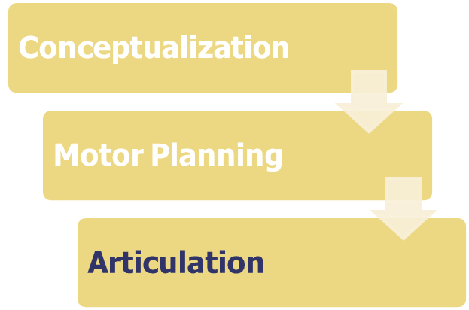
The Process of Speech Production
Stages of Speech Production
Muscles in the vocal
tract execute
precise movements
to produce speech
sounds based on
motor plans

Slide 15
Short-Time Fourier Representation of Speech

Slide 16
Short-Time Fourier Representation of Speech
Introduction
Overview of Spectrogram Analysis:
Introduction to time-frequency analysis methods for speech signals.
Role of STFT in Speech Processing:
STFT is a valuable tool for analyzing non-stationary signals like speech by revealing its time-varying frequency content.

Slide 17
Short-Time Fourier Representation of Speech
Introduction
Overview of Spectrogram Analysis:
  Spectrogram analysis is crucial for examining the time-varying frequency content of non-stationary signals like speech.
Role of STFT in Speech Processing:
  The Short-Time Fourier Transform (STFT) analyzes how a signal's frequency content changes over time.
  In speech processing, STFT helps visualize and understand the spectral characteristics of speech signals, which is essential for speech recognition, identification, and enhancement.

Slide 18
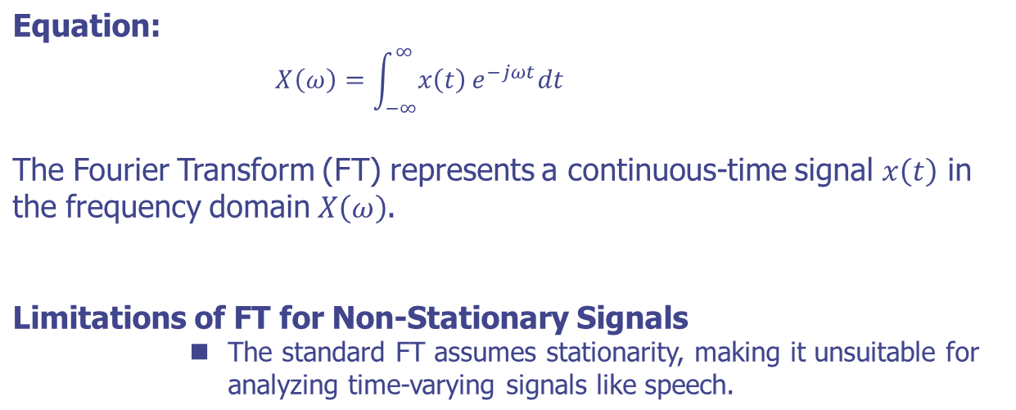
Short-Time Fourier Representation of Speech
Basics of Fourier Transform

Slide 19
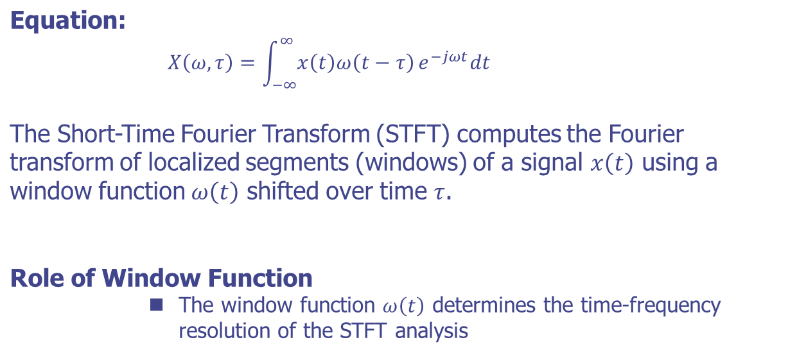
Short-Time Fourier Representation of Speech
Short-Time Fourier Transform (STFT)

Slide 20
Short-Time Fourier Representation of Speech
Practice
Objective:
Implement the Short-Time Fourier Transform (STFT) algorithm to analyze the frequency content of a speech signal and visualize the spectrogram.
Requirements
  Python environment with NumPy and SciPy installed.
  A speech signal (audio file in WAV format) for analysis

Slide 21
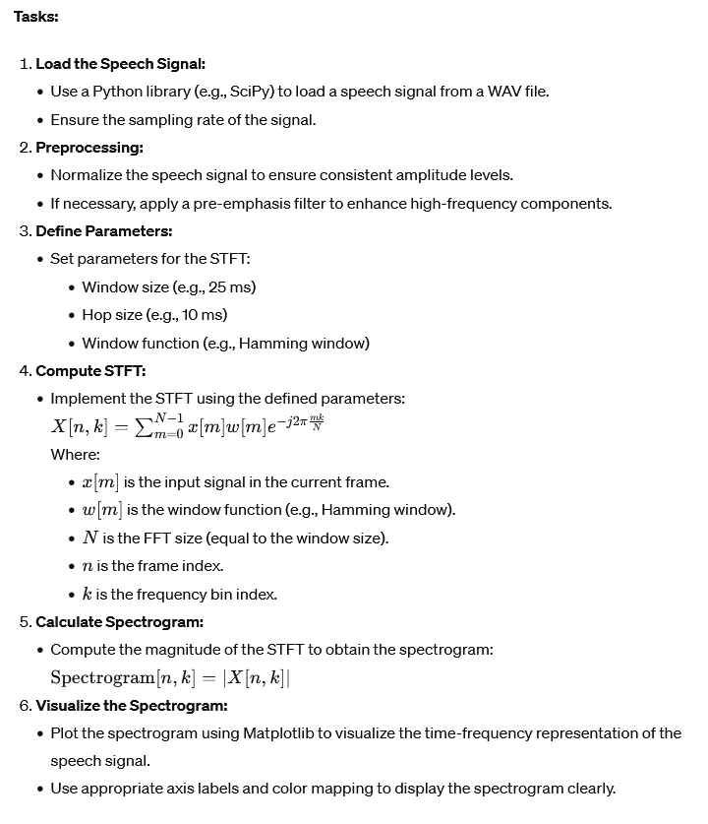
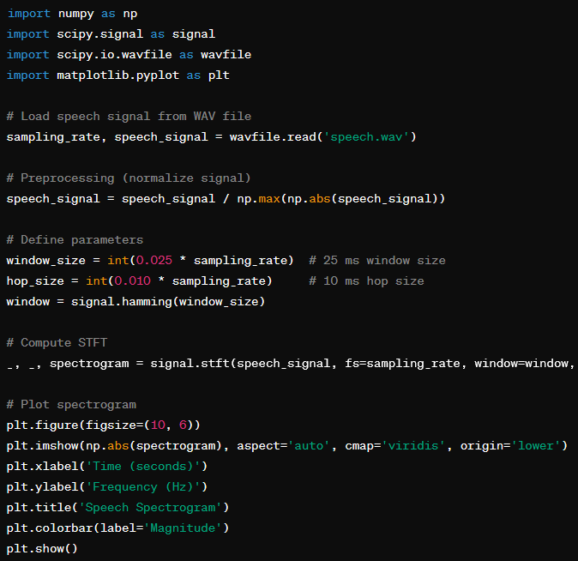
Short-Time Fourier Representation of Speech
Practice
Example

Slide 22
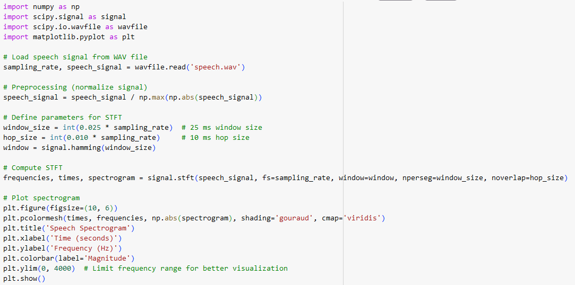
Short-Time Fourier Representation of Speech
Solutions

Slide 23
Acoustic Phonetics

Slide 24
Acoustic Phonetics
Introduction
Definition of Acoustic Phonetics
  Acoustic phonetics deals with the physical properties of speech sounds, particularly how they are produced, transmitted, and perceived as acoustic signals.
Importance of Acoustic Analysis
  Acoustic analysis helps us understand the relationship between articulatory movements (how speech sounds are produced) and the resulting acoustic properties (how they sound).

Slide 25
Acoustic Phonetics
Acoustic Properties of Speech Sounds
Fundamental Frequency (F0):
  The fundamental frequency represents the rate of vibration of the vocal folds and is perceived as pitch. It is measured in hertz (Hz).
Formants (F1, F2, F3)
  Formants are resonant frequencies of the vocal tract that characterize different vowel sounds. They are crucial for vowel perception and are measured in Hz.
Spectral Characteristics
  Speech sounds exhibit specific spectral patterns (spectra) due to the resonance frequencies of the vocal tract, which encode information about consonants and vowels.

Slide 26
Acoustic Phonetics
Measurement Techniques in Acoustic Phonetics
Waveform Analysis
  Waveform analysis involves visualizing speech signals in the time domain, showing amplitude variations over time.
Spectrogram Analysis
  Spectrograms display speech signals in the time-frequency domain, revealing how energy is distributed across different frequencies over time.
Pitch and Formant Analysis
  Pitch can be estimated by analyzing the fundamental frequency, while formants are identified through spectral analysis techniques.

Slide 27
Acoustic Phonetics
Acoustic Analysis of Vowels
Vowel Acoustics:
Distinct patterns of formant frequencies characterize vowels. For example:
  High front vowel (/i/) typically has high F1 and F2 frequencies.
  Low back vowel (/a/) exhibits lower F1 and higher F2 frequencies.
Example:
Display spectrograms and corresponding formant tracks of vowel sounds to illustrate their acoustic properties.

Slide 28
Acoustic Phonetics
Acoustic Analysis of Consonants
Consonant Acoustics
Consonants are distinguished by specific acoustic cues related to place and manner of articulation:
  Place of articulation: Changes in the frequency spectrum due to constriction location (e.g., /p/ vs. /t/ vs. /k/).
  Manner of articulation: Variations in the temporal and spectral characteristics (e.g., stops, fricatives, nasals).
Example:
Show spectrograms highlighting different acoustic features of consonant sounds.

Slide 29
Acoustic Phonetics
Future Directions in Acoustic Phonetics
Advances in Technology
Machine learning and deep learning techniques are transforming acoustic phonetic research, enabling more sophisticated analyses.
Multimodal Approaches
Integration of acoustic data with articulatory and linguistic information for comprehensive phonetic studies.
Research Opportunities
Using advanced acoustic methodologies, explore emerging areas such as cross-linguistic studies, speech synthesis, and neurophonetics.

Slide 30
Distinctive Features of The Phonemes English

Slide 31
Distinctive Features of The Phonemes English
Introduction
Definition of Distinctive Features
  Distinctive features are specific properties or attributes of speech sounds that contrast phonemes in a language.
  These features are crucial in phonological analysis and distinguishing between minimal pairs.
Role in Phonology
  Understanding distinctive features helps explain sound alternation, assimilation, and dissimilation patterns in phonological processes.

Slide 32
Distinctive Features of The Phonemes English
Voicing
Definition of Voicing
Voicing refers to whether the vocal cords are vibrating during the production of a consonant.
Distinctive Feature
English contrasts voiced and voiceless consonants, such as /b/ (voiced) vs. /p/ (voiceless) and /z/ (voiced) vs. /s/ (voiceless).
Example
Show spectrograms or waveforms of minimal pairs like "bat" /bæt/ (voiced) and "pat" /pæt/ (voiceless) to illustrate the voicing distinction.

Slide 33
Distinctive Features of The Phonemes English
Place of Articulation
Definition of Place of Articulation
Place of articulation refers to where in the vocal tract the airflow is obstructed to produce a consonant sound.
Distinctive Features
English distinguishes consonants based on their place of articulation, such as bilabial (/p/, /b/), alveolar (/t/, /d/), and velar (/k/, /g/).
Example:
Contrast minimal pairs like "pat" /pæt/ (bilabial) and "tat" /tæt/ (alveolar) to highlight the place of articulation differences.

Slide 34
Distinctive Features of The Phonemes English
Manner of Articulation
Definition of Manner of Articulation:
Manner of articulation refers to how the airflow is modified to produce a consonant sound.
Distinctive Features
English includes stops (/p/, /t/, /k/), fricatives (/f/, /s/, /ʃ/), affricates (/tʃ/, /dʒ/), nasals (/m/, /n/, /ŋ/), and more based on manner of articulation.
Example
Display spectrograms or waveforms of different consonant types (e.g., /p/ as a stop, /s/ as a fricative) to demonstrate manner of articulation.

Slide 35
Distinctive Features of The Phonemes English
Nasality
Definition of Nasality:
Nasality refers to whether the airflow is directed through the nasal cavity (nasal sounds) or solely through the oral cavity (oral sounds).
Distinctive Features
English contrasts nasal consonants (/m/, /n/, /ŋ/) with their oral counterparts.
Example
Show spectrograms or waveforms of words containing nasal sounds (e.g., "man" /mæn/) and contrast them with oral sounds (e.g., "pan" /pæn/).

Slide 36
Distinctive Features of The Phonemes English
Vowel Height
Definition of Vowel Height:
Vowel height refers to the position of the tongue in the mouth relative to the palate when producing a vowel.
Distinctive Features
English vowels can be high (/i/, /u/), mid (/ɛ/, /ʌ/), or low (/æ/, /ɑ/) based on vowel height.
Example
Compare spectrograms or vowel diagrams of high (/i/ in "see"), mid (/ʌ/ in "but"), and low (/ɑ/ in "father") vowels to illustrate vowel height distinctions.

Slide 37
Distinctive Features of The Phonemes English
Vowel Backness
Definition of Vowel Backness:
Vowel backness refers to the tongue’s position in the mouth along the front-back axis when producing a vowel.
Distinctive Features
English vowels can be front (/i/, /ɛ/), central (/ʌ/, /ə/), or back (/u/, /ɔ/) based on vowel backness.
Example
To illustrate vowel backness distinctions, show spectrograms or vowel diagrams of the front (/i/ in "see"), central (/ʌ/ in "but"), and back (/ɔ/ in "thought") vowels.

Slide 38
Distinctive Features of The Phonemes English
Rhoticity
Definition of Rhoticity:
Rhoticity refers to the presence or absence of the rhotic consonant /r/ in the pronunciation of vowels.
Distinctive Features
English dialects vary in rhoticity, where the pronunciation of vowels can differ significantly depending on the presence or absence of /r/.
Example
Contrast American English "car" /kɑr/ (rhotic) with British English "car" /kɑː/ (non-rhotic) to demonstrate rhoticity differences.

Slide 39
Q & A

